Slide 1
SH Movies success
implies + TV Series ?
Metis SF Spring 2018 – Project Luther
Filippo Medri

Slide 2
IMPORTANT NOTE – do not edit this slide, builds content art elements before going to next content slide. Should go between title/section title slides and content slides.

Slide 3

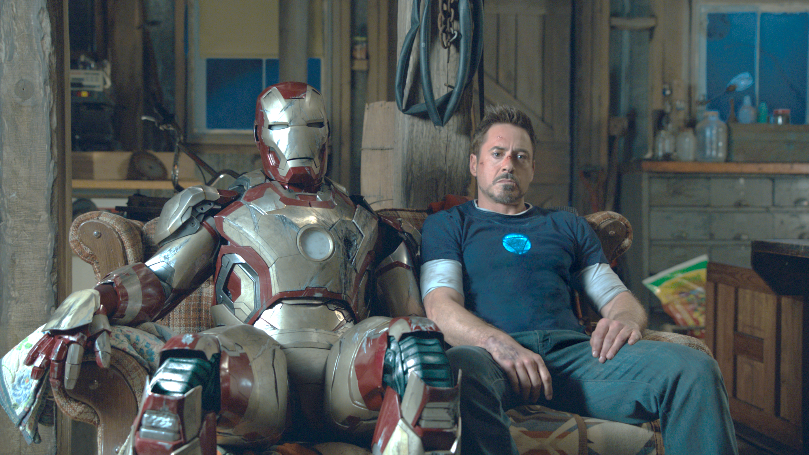

Problem Statement
GOAL
“Does the success of Super Hero Movies affects the number of Super Hero TV Series of the next year? ”
Scraped data from 2501 Titles
Source: www.IMDB.com
From (“The Green Archer - 1920”)
To (“Defenders of the Gao – 2020”)
Created 2 Different Dataset:
Movies ← For feature extraction
TV Series ← For response variable

Slide 4
Blank Slide With Jarvis Background

Slide 5

Features
Movies
Tv Series
IMDB Score
Number of IMDB users rating
Metascore from Metacritics
N. of reviews from users
N. of reviews from critics
Opening WE gross ( USA)
Gross (USA)
Gross (world wide)
Number of TV Series per year
Final Dataset
204 Entries
From 1978 to 2018

Slide 6
Next →
Sample Section Subtitle

Slide 7
Blank Slide Without Jarvis Background

Slide 8
Sample Slide Title
Sample Title Column 1
Sample Title Column 2
Sample Content Item 1
Sample Content Item 2
Sample Content Item 3
Sample Content Item 1
Sample Content Item 2
Sample Content Item 3

